Slide 1


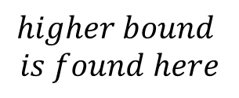


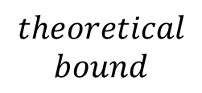


$$I_{u}$$
$$theoretical$$
$$bound$$
$$0.6$$
$$I_{au}$$
$$higher bound$$
$$is found here$$
$$0.4$$
$${\overline{I}}_{au}$$
$$new bound$$
Iteration 1
Iteration 2
Iteration 3
Iteration 4

